Slide 1
Automotive Road-Side Assistance
Emergency roadside assistant and digital dispatch technology.

Slide 2
Challenges
Opportunities
To dispatch a tow truck, an Agent makes several inbound/outbound calls to connect driver & Tow
Reduction in calls
Increased Call Volume, AHT, and Lower productivity
Limited engagement among agents
Average Customer satisfaction
Mundane & non-productive tasks
Redundant Process, Delayed Responses in certain cases
Limited customer info available
Higher cost to the client
Too many screens for agents

Slide 3


Our Approach
A bot that taps into the database, knowledge base and uses machine learning algorithms such as natural language processing (NLP), deep neural networks etc. to understand the context of the customer’s problem. Accordingly, the bot triggers relevant back-end activities such as dispatch to start out transactional processing. This reduces the overall effort by agents for a faster response time.
© HGS DIGITAL

Slide 4







Customer Journey
CUSTOMER LOOKUP
DIAGNOSE
SOLUTION
LOCATION
DISPATCH
CONFIRMATION
CLOSE/SURVEY
Vehicle and Rental Agreement
Customer ID
Car Information
Issue Identification
Battery, Spare Parts, and Gas
Number of Passengers
Tow Details
Flat Bed or Tow
Leaving Vehicle
Quick Fix
Vehicle Location
Cross Street
SMS to Locate
Location Confirmation
SMS to Locate
Find a Tow
Locate Tow to Destination
Validate and Document Dispatch Details
Communicate Tow Company Details to the Customer
Share ETA, Cost, and Confirmation
Check/Provide Customer Dispatch Contact
Confirm Vehicle Tow
Collect Email
Send Documents
Send Survey
Close Case

Slide 5
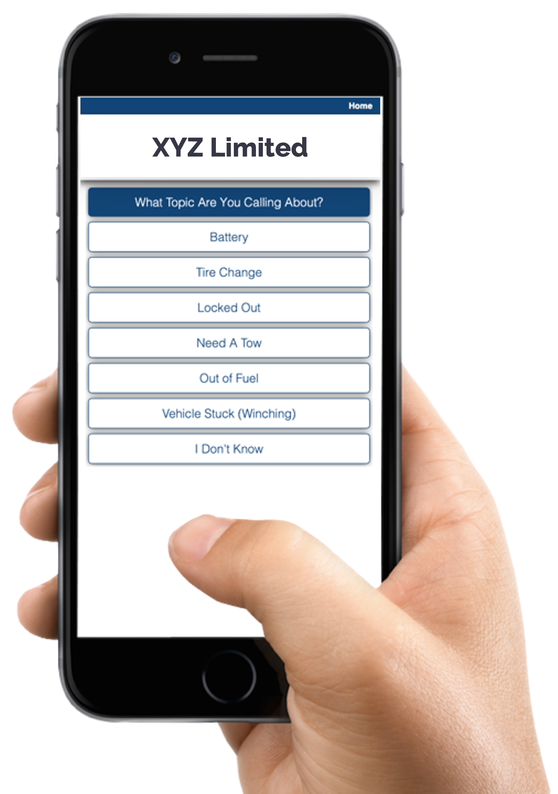
What is AxleTM Bot?
AxleTM is an automated dispatch assistant that answers drivers calls for help, captures basic information, and triages or dispatches experts.
Axle supplements existing systems and processes to save time and money – an estimated savings of 10-14 minutes or $5 to $7 per call.
Axle can be used by your in-house or outsourced call center teams.
No capital expense, pay per use model

Slide 6

Who Is It For?
AxleBot is useful for anyone responsible for managing and supporting a commercial vehicle fleet.
Automotive Manufacturing and Dealers
Rental Vehicle Companies
Automotive Associations
Insurance Companies
Courier and Logistics Companies
Transit Systems
Tow Truck and Taxi Companies
Construction and Engineering Firms
Utility Providers and Traders
Fleet Management Software Providers
© HGS DIGITAL

Slide 7
Why Is It Valuable?
FOR THE DRIVER
Convenient support channels (phone, app, text)
Faster, more accurate response
Real-time status updates
Automatic notifications, reminders, and alerts
Available 24/7/365
Multiple languages and geographies
Presents authorized options clearly
Gathers feedback so the company can improve
Confidentiality, privacy, and secure handling of personal information
Peace of mind and reliability
FOR THE FLEET MANAGER
Decreases downtime for assets
No capital investment required
Integrates with existing systems and teams
Provides analytics and real-time reporting
Reduces contact center average handle time
Enables staff to focus on more complex tasks
Easy and fast to implement
Can include revenue generation opportunities
Automates repair/purchase authorizations
Keeps records up to date
Requires little maintenance

Slide 8



HGS AxleTM Bot Benefits
CUSTOMER EXPERIENCE
DIGITAL TRANSFORMATION
COST OPTIMIZATION
Faster & precise responses during Adverse events with 24x7 coverage
Transfer over to a human agent seamlessly with transcription and notes for a more fluid CX
User data & feedback can be Analyzed to gain new insights
Confidential and secure handling of personal information
Automatic real time notifications, reminders & Alerts
Scalable standardized solution across multiples brands and offerings
Reduce agent effort and volumes while optimizing cost
Long-term saving through scalability across other LOB
Support multiple languages & geographies

Slide 9



Highlights
IMPLEMENT HGS AXLETM SMARTBOT
To address this challenge, HGS Digital introduced AxleTM, a smartbot for collecting customer information. This human-centric, custom-built solution allows for faster dispatch, real-time tracking, and mobile notifications for the driver in distress. When a person contacts the company via a phone call, SMS, or mobile messaging, our dispatching platform finds the nearest tow truck, dealership, and/or mechanic.
PROVIDE LOCATION AND STATUS INFO FOR EVERYONE INVOLVED
Through a series of workflows, drivers proceed through the step-by-step process, answering questions to ensure the right solutions are selected to acquire roadside assistance. If necessary, integrated geolocation services also help locate the driver and find the closest tow destinations, and via GPS, all parties can monitor AxleTM to view the status of the tow truck or other next steps in real time.
CLIENT SUCCESS STORY: AUTOMOTIVE
Alleviating stranded driver stress and expediting Emergency Roadside Service (ERS) with HGS Axle™ Bot
Key results
This US-based rental car company was exploring ways to reduce the average time drivers spend in stressful and potentially dangerous situations to receive Emergency Roadside Service (ERS). HGS Digital employed an award-winning, user-friendly smartbot that makes requesting roadside assistance easy, and helps drivers get back into a functioning vehicle as safely and as soon as possible.
6.5K
47%
24%
Total bot-managed interactions
Cases related to towing or tire changes
Increase in agent capacity with AxleTM

